Slide 1
Course: Cloud, Microservices and Application
UNIT I: INTRODUCTION
SESSION 3
Cloud Service models/Cloud Types
Date: 16/7/2021

Slide 2
Cloud Service Models or Cloud Types
The National Institute of Standards and Technology (NIST) defines three basic service models, namely,
IaaS
PaaS
SaaS
as shown in Figure

Slide 3
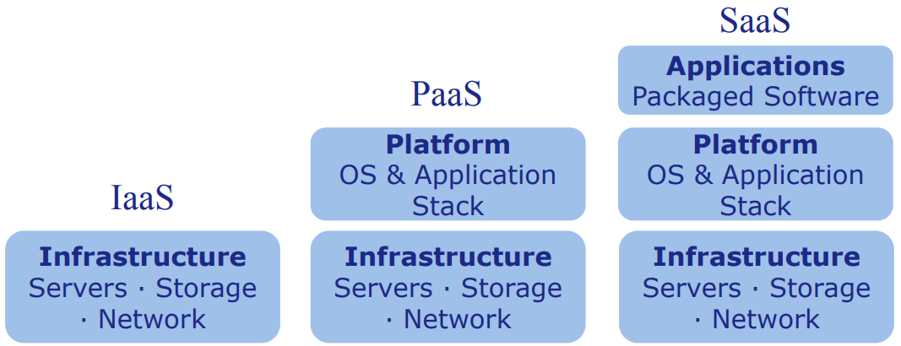
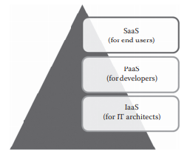
Image Source: K. Chandrasekaran, “Essentials of Cloud Computing”, 2nd Edition, CRC Press, 2015 and “Introduction to Cloud Computing”, Jim Dowling, Royal Institute of Technology

Slide 4
Infrastructure as a Service (IaaS)
The ability given to the infrastructure architects to deploy or run any software on the computing resources provided by the service provider.
Here, the underlying infrastructures such as compute, network, and storage are managed by the service provider.
Thus, the infrastructure architects are exempted from maintaining the data center or underlying infrastructure.
The end users are responsible for managing applications that are running on top of the service provider cloud infrastructure.
Continue...

Slide 5
Infrastructure as a Service (IaaS)
Generally, the IaaS services are provided from the service provider cloud data center.
The end users can access the services from their devices through web command line interface (CLI) or application programming interfaces (APIs) provided by the service providers.
Some of the popular IaaS providers include
Amazon Web Services (AWS)
Google Compute Engine
OpenStack
Eucalyptus.

Slide 6
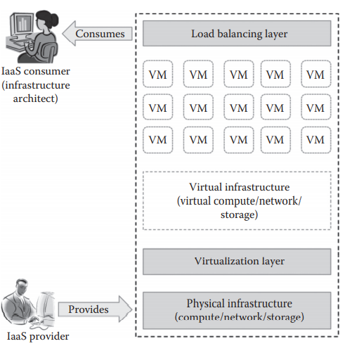
Overview of IaaS
Image Source: K. Chandrasekaran, “Essentials of Cloud Computing”, 2nd Edition, CRC Press, 2015

Slide 7
Services provided by IaaS providers
Compute: Computing as a Service includes virtual central processing units (CPUs) and virtual main memory for the VMs that are provisioned to the end users.
Storage: STaaS provides back-end storage for the VM images. Some of the IaaS providers also provide the back end for storing files.
Network: Network as a Service (NaaS) provides virtual networking components such as virtual router, switch, and bridge for the VMs.
Load balancers: Load Balancing as a Service may provide load balancing capability at the infrastructure layer.

Slide 8
Characteristics of IaaS
Web access to the resources
Centralized management
Elasticity and dynamic scaling
Shared infrastructure
Preconfigured VMs
Metered services

Slide 9
Suitability of IaaS
Unpredictable spikes in usage
Limited capital investment
Infrastructure on demand

Slide 10
Benefits provided by IaaS
Pay-as-you-use model
Reduced TCO
Elastic resources
Better resource utilization
Supports Green IT

Slide 11
Drawbacks of IaaS
Security issues
Interoperability issues
Performance issues

Slide 12
Platform as a Service (PaaS)
The ability given to developers to develop and deploy an application on the development platform provided by the service provider.
Thus, the developers are exempted from managing the development platform and underlying infrastructure.
Here, the developers are responsible for managing the deployed application and configuring the development environment.

Slide 13
Platform as a Service (PaaS)
Generally, PaaS services are provided by the service provider on an on-premise or dedicated or hosted cloud infrastructure.
The developers can access the development platform over the Internet through web CLI, web user interface (UI), and integrated development environments (IDEs).
Some of the popular PaaS providers include
Google App Engine
Force.com
Red Hat OpenShift
Heroku
Engine Yard

Slide 14
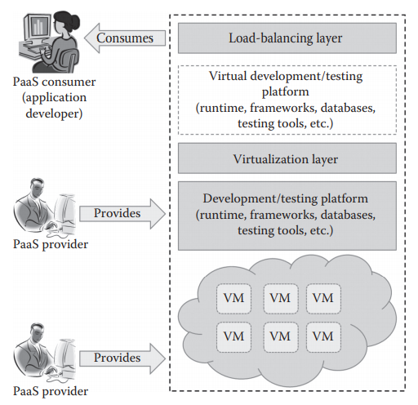
Overview of PaaS
Image Source: K. Chandrasekaran, “Essentials of Cloud Computing”, 2nd Edition, CRC Press, 2015

Slide 15
Services provided by PaaS providers
Programming languages
Application frameworks
Database
Other tools: PaaS providers provide all the tools that are required to develop, test, and deploy an application.

Slide 16
Characteristics of PaaS
All in one
Web access to the development platform
Offline access
Built-in scalability
Collaborative platform
Diverse client tools

Slide 17
Suitability of PaaS
Collaborative development
Automated testing and deployment
Time to market

Slide 18
Benefits of PaaS
Quick development and deployment
Reduces TCO
Supports agile software development
Different teams can work together
Ease of use
Less maintenance overhead
Produces scalable applications

Slide 19
Drawbacks of PaaS
Vendor lock-in
Security issues
Less flexibility
Depends on Internet connection

Slide 20
Software as a Service (SaaS)
The ability given to the end users to access an application over the Internet that is hosted and managed by the service provider.
Thus, the end users are exempted from managing or controlling an application, the development platform, and the underlying infrastructure

Slide 21
Software as a Service (SaaS)
Generally, SaaS services are hosted in service provider– managed or service provider–hosted cloud infrastructure.
The end users can access the services from any thin clients or web browsers.
Some of the popular SaaS providers include
Saleforce.com
Google Apps
Microsoft office 365

Slide 22
Services provided by SaaS Providers
Business services
Social networks
Document management
Mail services

Slide 23
Characteristics of SaaS
One to many
Web access
Centralized management
Multidevice support
Better scalability
High availability
API integration

Slide 24
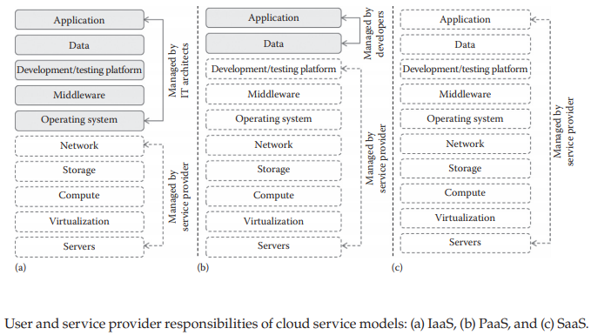
Image Source: K. Chandrasekaran, “Essentials of Cloud Computing”, 2nd Edition, CRC Press, 2015

Slide 25
Any Questions???

Slide 26
Thank You

